Slide 1
Youtube Trending Data Analysis
Aws project
Aryan Kamble

Slide 2
Problem statement
The phenomenon of YouTube trending videos varies significantly across different regions, influenced by cultural preferences, language, and regional trends. However, there exists a gap in understanding how various factors such as likes, comments, video categories, and language contribute to the trending status of YouTube videos within specific regions.
This project aims to address this gap by conducting a detailed analysis of YouTube trending data, focusing on regional nuances and the influence of key factors.

Slide 3
Objectives
Regional Variation: Explore how trending videos differ across regions in categories, language, and engagement metrics.
Likes and Comments: Assess the impact of likes and comments on trending likelihood in different regions.
Category Preferences: Identify prevalent video categories and their regional popularity.
Language Influence: Analyze how video language affects trending in specific regions.
Cross-Regional Trends: Investigate global trends shaping regional YouTube dynamics.

Slide 4
Project Solutions and Goals
Data Ingestion
Ingest data,one-offs and incrementally
ETL Design
Extract, transform and load data efficiently
Data Lake
Design and build a new Data Lake architecture
Scalability
The data architecture should scale efficiently
AWS cloud
AWS as the cloud provider
Reporting
Build a Business Intelligence tier , incl Dashboards

Slide 5
Youtube Dataset
In this project , I’m using the Youtube Trending videos dataset from Kaggle.
This dataset contains 2 types of files partitioned based on regions - category.json and videos.csv. These files contain data like video category ,number of views, shares , comments ,likes ,etc.
Data is collected by Youtube’s own API.

Slide 6

AWS S3 as an ingestion point for our raw data
Data will be uploaded here using AWS CLI
Later, the cleansed analytical data will also be stored here in separate bucket.
AWS S3

Slide 7
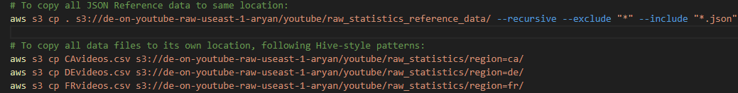
Uploading data to S3 using the aws s3 cp command.
Raw-data-bucket (R-1(json + csv) ).
Note : All json data is uploaded in the same directory , wheres csv data will be placed in their region directory respectively.
I’m uploading this data in such a way that later when my data is imported into the Glue data catalog , it will maintain its partitioning based on region.

Slide 8
Cleaning procedure
Our cleaning procedure includes 2 steps.
First we’ll clean the json data containing categories and store them in one table.
Secondly, we’ll clean the csv data which contains the videos information and store them in another table.
Later we’ll inner join both the tables using category_id and id as references.
Finally, this table is ready to visualize.

Slide 9

AWS Glue Data Catalog for data warehousing.
Initially a crawler(raw-json) will parse the raw json data and create a catalog around it making it ready for further operations.
An IAM role for Glue with permissions for S3FullAcces is set up to keep resource access restricted.
The crawler will parse the data and will save it under a Table in Glue Database (D1-T1(json))
AWS Glue

Slide 10

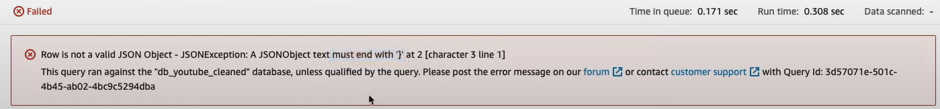
AWS Athena for querying data .
We’ll use Athena for querying our data . We’ll have to create a new s3 bucket as it stores its query results. (Ath-1).
Tables from Glue database will be viewed and queried here.
Initially, if we run a query to show table data , we’ll encounter an error. The reason behind this is the data we require is contained in an array
AWS Athena

Slide 11
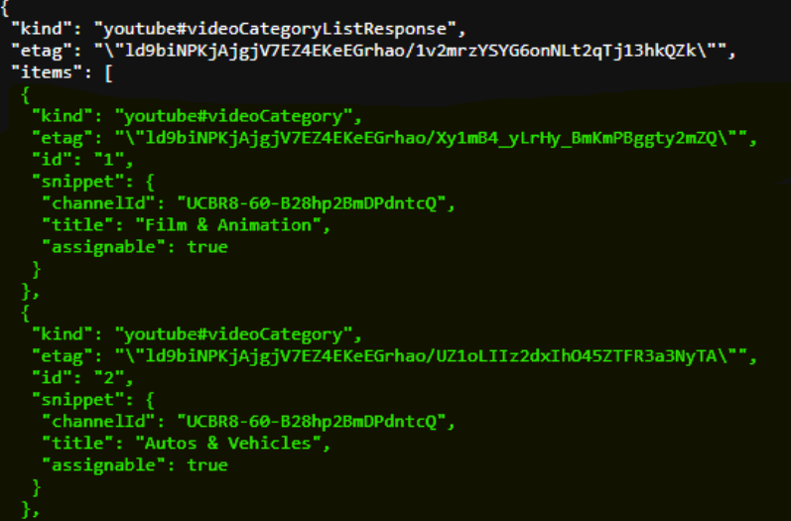
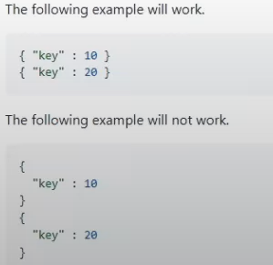
We only require the data in green but glue fails to do so.
The reason behind why Glue is not able to parse this data is because of a thing called Json SerDe (serialize and deserialize).
In layman terms , glue requires all its contents in one single line rather than in multiple lines.
To fix this…...

Slide 12
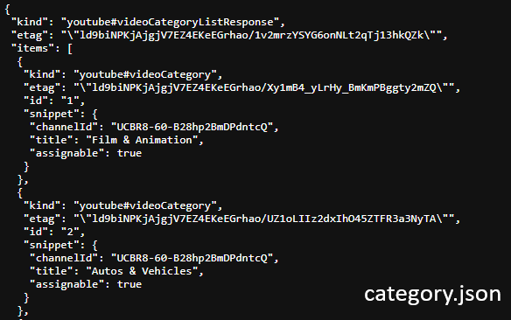
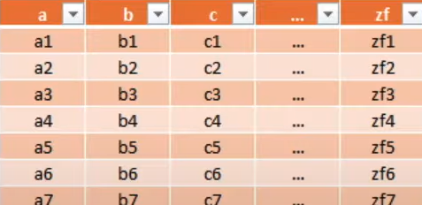
We will convert our JSON data to Apache Parquet format (tabular)

Slide 13
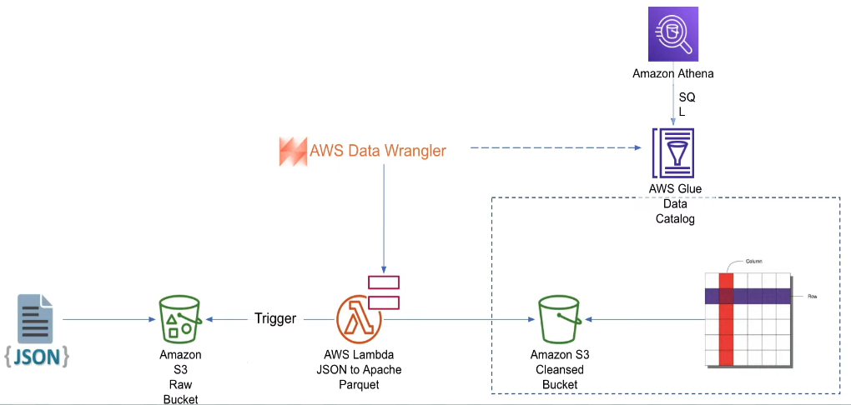
Data cleaning : Semi-structured data to Structured data pipeline

Slide 14
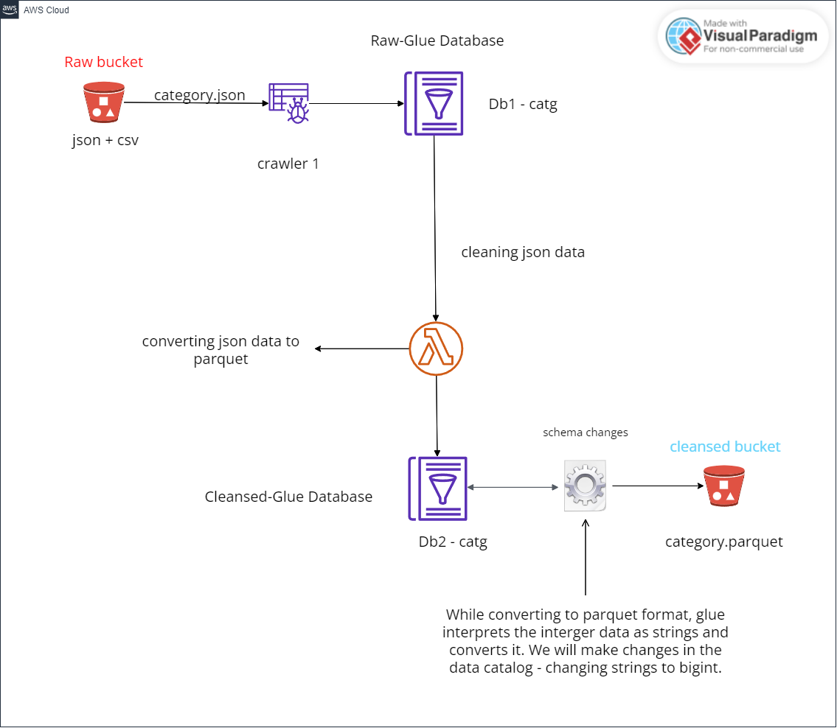
Data cleansing : cleaning json data

Slide 15
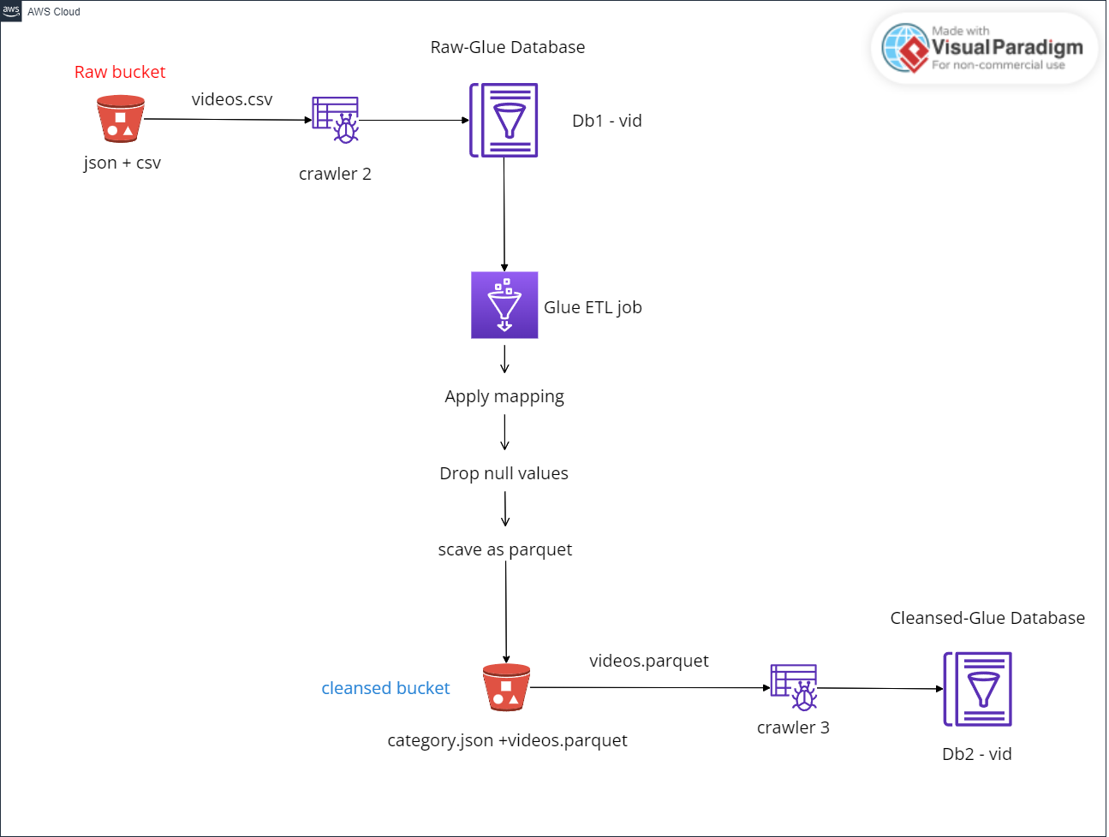
Data cleansing : cleaning csv data

Slide 16
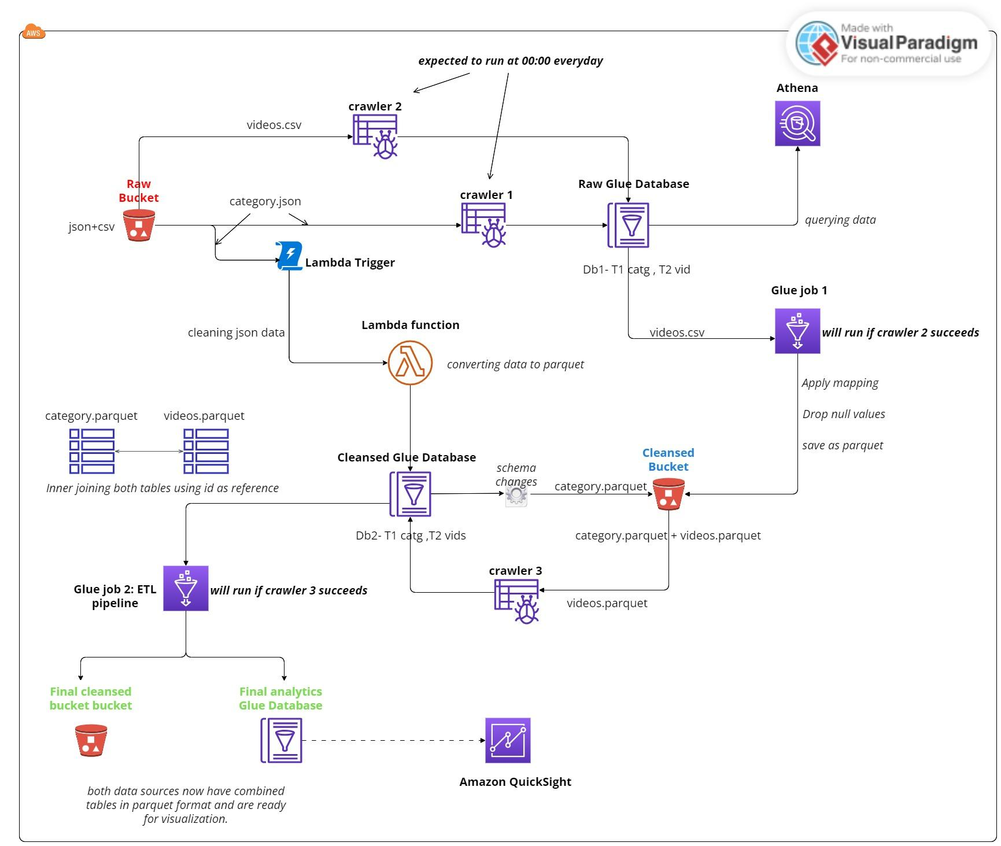
Data flow

Slide 17
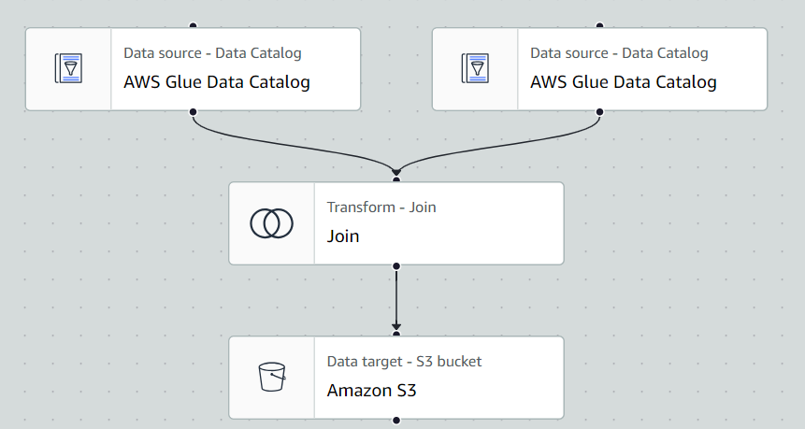
Glue : ETL pipeline for generating final parquet cleansed data

Slide 18
Moving on to AWS QuickSight

Slide 19
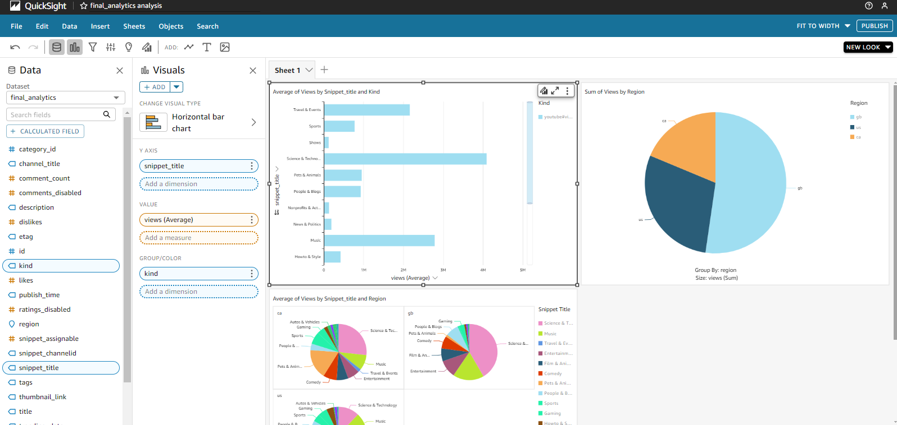
Quicksight : Analysis

Slide 20
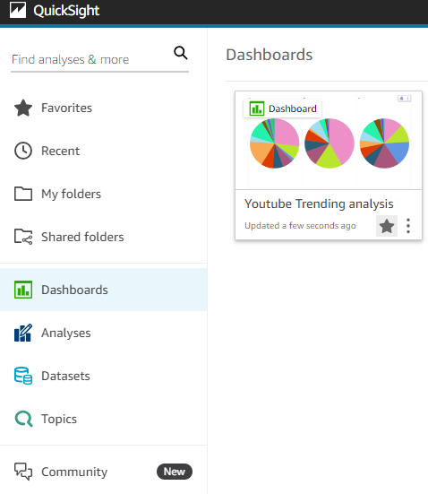
Quicksight : Published Dashboard

Slide 21
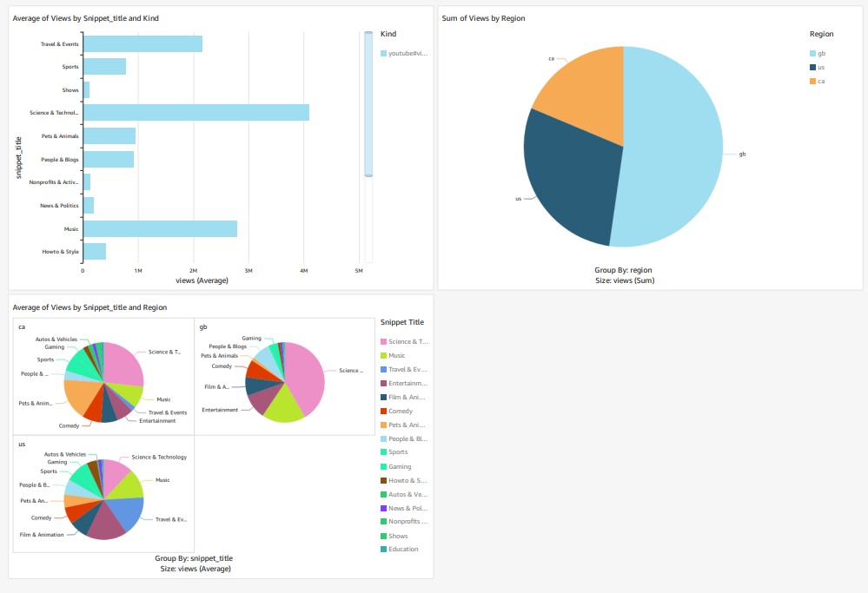
Quicksight : charts

Slide 22
Thank you

